Slide 1
Secure Data Hiding in Image Using Steganography
CAPSTONE PROJECT
Presented By:
Student Name : Satyajyoti Mohanty
College Name & Department : Centurion University of Technology & Management (CSE)

Slide 2
OUTLINE
Problem Statement
Technology used
Wow factor
End users
Result
Conclusion
Git-hub Link
Future scope

Slide 3
Problem Statement
With the rise of digital communication, data security is a major concern. Traditional encryption protects data but may attract attention. Steganography enables covert communication by hiding data in images, but challenges like image quality, attack resistance, and efficient embedding must be addressed.

Slide 4
Technology used
Programming Language & Platform:
Python: Used for implementing the steganography and encryption logic.
OpenCV: For image processing and manipulation.
NumPy: For efficient handling of image arrays.
Cryptography & Security:
Cryptography (Fernet, PBKDF2HMAC): Used for encrypting and decrypting messages securely.
Base64: For encoding encryption keys safely.
File Handling & OS Interaction:
OS Module: For file path handling and system operations.

Slide 5
Wow factors
Dual-Layer Security – Combines steganography (hiding data in images) with encryption (Fernet) for enhanced data protection.
Lossless Data Hiding – Ensures image quality is preserved while embedding the secret message.
Custom Password Protection – Uses PBKDF2HMAC key derivation for secure, password-based encryption.
User-Friendly & Automated – Simple menu-driven interface for encoding and decoding messages effortlessly.

Slide 6
End users
Researchers & Students

Slide 7
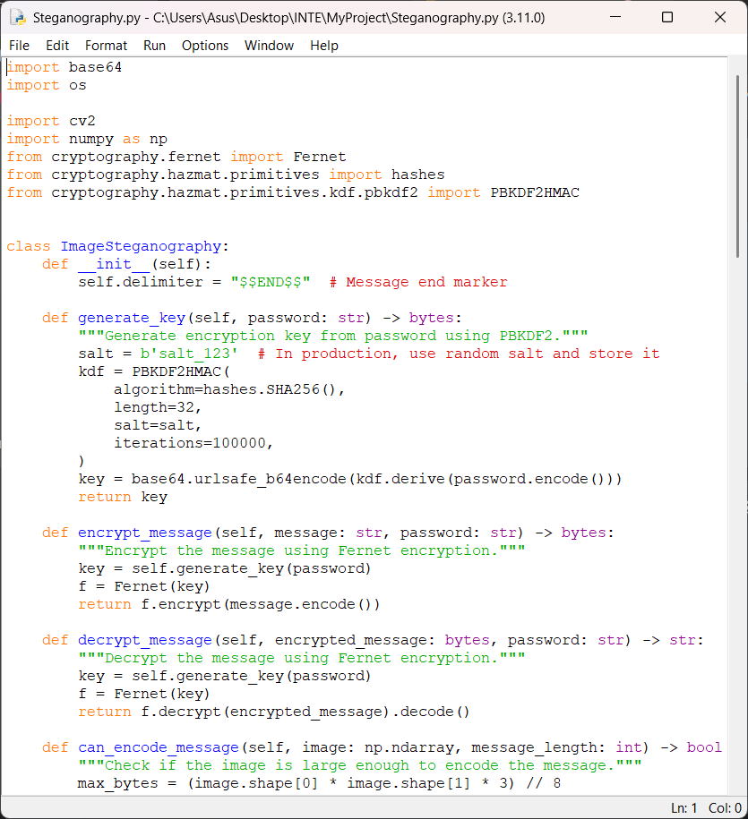
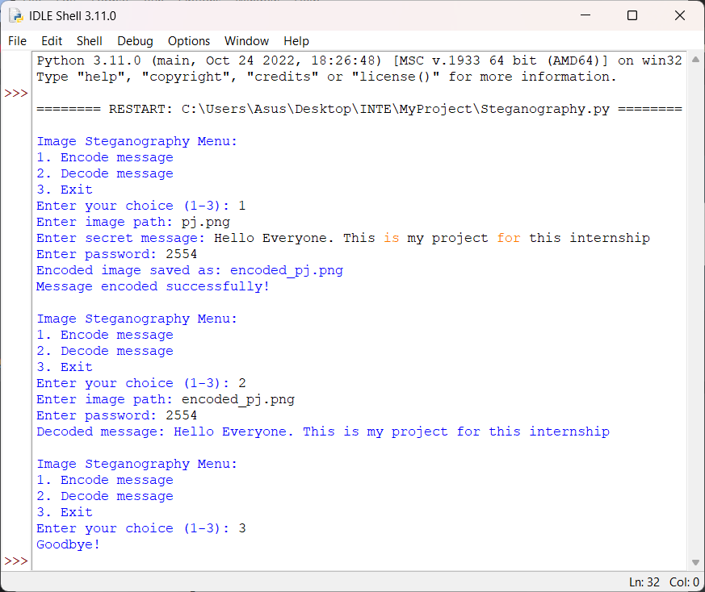

Results

Slide 8
Conclusion
This project successfully addresses the challenge of secure data transmission by integrating steganography with encryption for enhanced privacy. Unlike traditional encryption, which may attract attention, this method discreetly hides encrypted messages within images, making detection difficult. By ensuring data confidentiality, integrity, and resistance to attacks, the project provides a robust and user-friendly approach to covert communication.

Slide 9
GitHub Link
https://github.com/Zenus004/AICTE.git

Slide 10
Future scope(optional)
Advanced Encryption Techniques – Implementing stronger encryption algorithms like AES-256 for enhanced security.
Support for Multiple File Formats – Extending compatibility beyond images to audio, video, and documents for broader applications.
Dynamic Key Management – Implementing blockchain or distributed key sharing for secure and decentralized key management.

Slide 11
THANK YOU

